Slide 1
The influence of certain factors on combined Systolic Blood Pressure Reading
By: Purumidha Sharma

Slide 2
Introduction Section

Slide 3
Introduction Section
Objective of this study is to
Find out effect of smoking on blood pressure,
look for more variables to see if blood pressure changes are based on it
Using 2011-2012 dataset from NHANES
Relevance to health and nutrition surveys impacted by variables like income, age, gender, marital status, smoking and much more

Slide 4
Methods Section
Describing and explaining the methods, tools and techniques used to arrive at my final model here and showing exploratory data analysis (graphs and tables).

Slide 5
Methods Section
Model Diagnostics (for full model: includes normality QQ plot, residual plots, Influential Observation Techniques (Cooks, DFFITS, DFBETAS))
Checking for the variance inflation factor (VIF) for detecting multicollinearity between predictors
Variable selection method such as stepwise regression for AIC, BIC, and then Lasso selection to compare which model will be the best
Shrinkage methods (LASSO: for variable selection)
Model Validation (cross validation method)
Model diagnostic (checking if regression assumptions hold for final model)

Slide 6
Results and Discussion Section
PRESENTS a description of study sample, important results that led to make crucial decision in building THE model, and the final model and any other important results
Interpreting the final model and describing why it answers the research question and why it is important, as well as discuss any limitations that still exist based on my results.

Slide 7
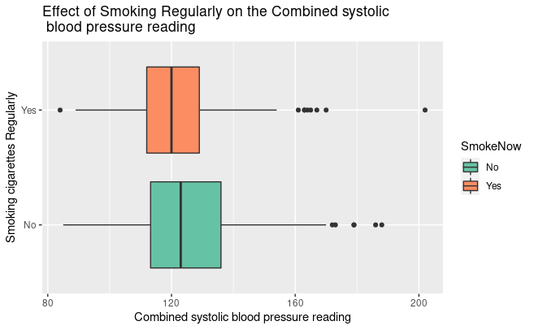
Association between Smoking and Combined Systolic Blood Pressure Reading
The median of non-smokers is slightly higher than who smoke.
According to this boxplot, we can see those who smoke regularly have lower blood pressure compared to those who don’t regularly.
The overall conclusion is that blood pressure does vary with smoking versus not smoking regularly.

Slide 8
Discussion and Results
Methodology leading to the results
Perform model diagnostic check (for full model first) to make sure multiple regression model assumptions are not violated
Produce statistically significant data
Observe whether there are observations with bad leverage points or outliers that affect the analysis of the regression model.
In terms of Influential observation, Cook's distance did not have any, but DFFITS, and DFBETAS had influential observations.

Slide 9
Results Section
 | GVIF
Gender | 2.12
Age | 1.85
Race3 | 2.18
Education | 2.29
Marital Status (aged 20 years or older) | 2.32
Total annual gross income for the household (in US dollars) | 9.19
Poverty | 4.94
Weight | 100.63
Height | 26.88
BMI | 81.93
Depressed | 1.34
Sleep Hours at Night | 1.13
Trouble Sleeping | 1.23
Physically Active | 1.32
Currently smoking cigarettes regularly | 1.40
Multicollinearity occurs when independent variables are highly correlated with each other, which means that some predictors may be redundant [can predict certain predictor from the other predictors]. This will in turn make the least squares hard to estimates hard (or even impossible) to obtain and will cause variances to be extremely unstable.
**Refresher: The Variance Inflation Factor determines the degree to which collinearity increases the variance of a parameter estimate

Slide 10
Results Section
 | GVIF
Gender | 1.19
Age | 1.80
Race3 | 1.91
Education | 2.25
Marital Status (aged 20 years or older) | 2.29
Total annual gross income for the household (in US dollars) | 8.78
Poverty | 4.90
BMI | 1.12
Depressed | 1.32
Trouble Sleeping | 1.22
Physically Active | 1.31
Currently smoking cigarettes regularly | 1.39
Removed Weight and Height as the multicollinear terms.
BMI is calculated from weight and height already
BMI is the most accurate and simple way medical practitioners use as an indicator of someone’s health and disease risk. [using weight and height separately is not as accurate to see the effect on Blood Pressure]

Slide 11
Results Section: Variable Selection Method Results
These are the final variables selected by these method techniques
AIC | BIC | LASSO
Gender | Gender | Age
Age | Age
Marital Status (aged 20 years or older) | Poverty
Poverty
BMI
Trouble Sleeping

Slide 12
Results Section: Variable Selection Method Results
LIMITATIONS
AIC Stepwise Regression | BIC Stepwise Regression | LASSO
For finding test statistics for model, it can be larger than it should be, increasing the problem of Type I error. (p-values being significant when it shouldn’t be) Estimated coefficients we get from this model will actually be biased estimators Has a tendency to overfit for some situations (it needs a little more strong penalty, that is why why BIC is preferred more) | Penalizes terms more heavily than AIC. Its more consistent than AIC. Likes to stick to simpler models (caution in stepwise remains same) | Imagine if all categories were important, then LASSO would only choose one, and ignore other variables. It fails to do grouped selection, so I don’t think in our case it does a great job.

Slide 13
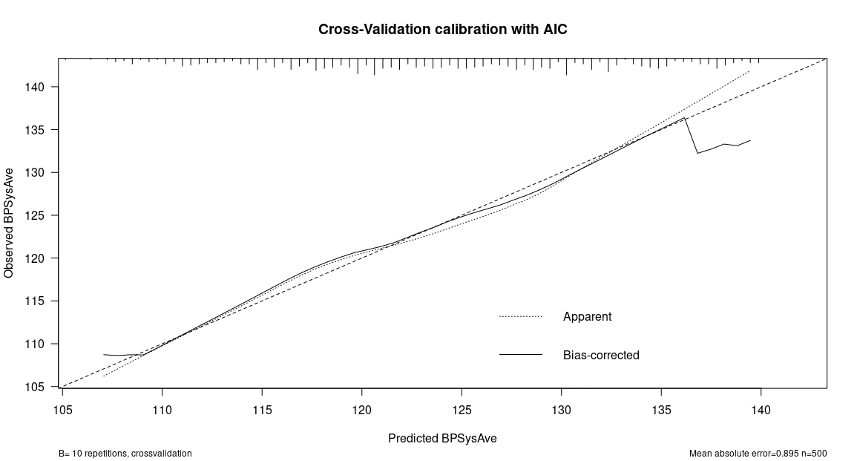
Results Section: Variable Selection Method Results
**Refresher: The "Ideal" line represents perfect prediction as the predicted probabilities equal the observed probabilities.
The "Bias Corrected" line is derived via a resampling procedure to fit model to data.
When bias-corrected line is above the "Ideal" line, this tells us the model underpredicts in a particular range of predicted probabilities. Whereas, when bias-corrected line is below the "Ideal" line, the model overpredicts in a particular range of predicted probabilities.
For this plot, it is much better than Lasso, but not compared to BIC

Slide 14
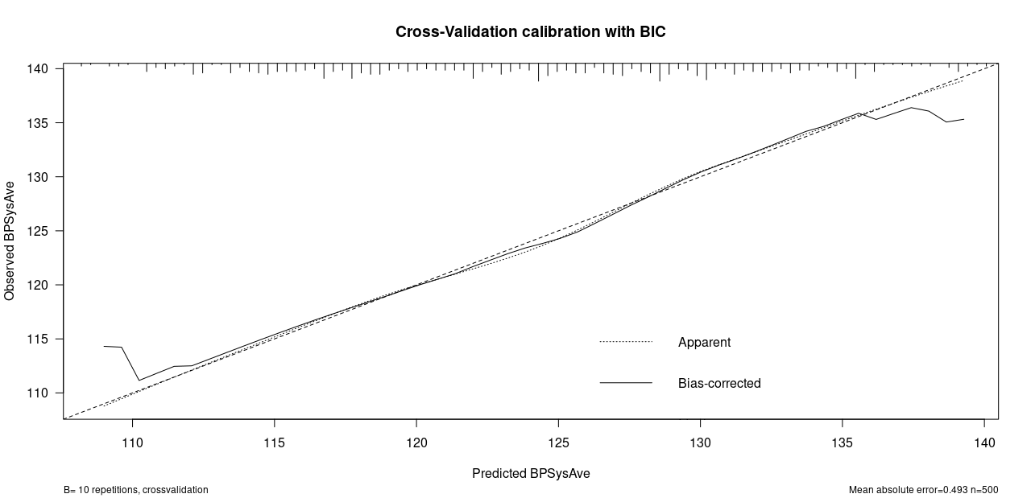
Results Section: Variable Selection Method Results
This model overall appears to be reasonably well calibrated based on the Bias-Corrected line closely following the Ideal line.
There is some underprediction less than 115 predicted probability, since bias-Corrected line is above the Ideal line.
Also, some overprediction > 135, since bias corrected line is below ideal line
Better model fit than AIC and Lasso

Slide 15
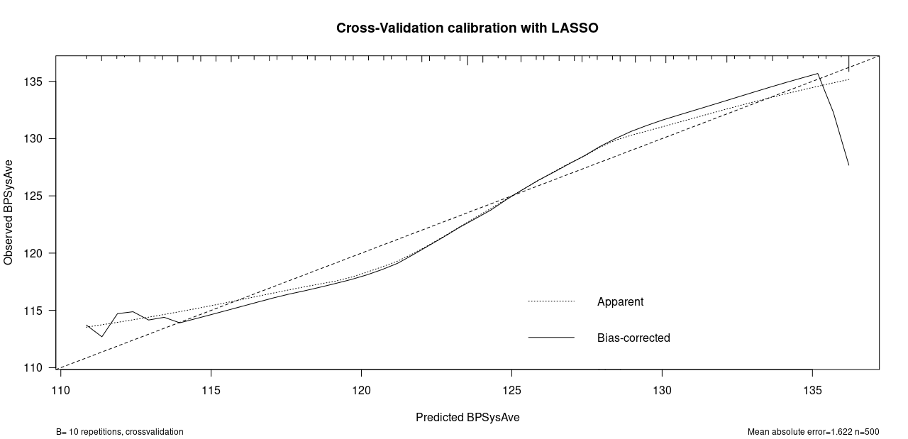
Results Section: Variable Selection Method Results
This model does not appear to be reasonably well-calibrated based on bias-corrected line closely following the ideal line.
There is way too much over and under fitting, which is bad for model analysis.
Poor model fit compared to AIC and BIC.

Slide 16
Results & Discussion Section: Cross Validation for variable selection technique described previously
Prediction Errors
AIC | BIC | LASSO
281.64 | 274.69 | 281.88
We want to choose the lowest prediction error (measure of how well the model predicts the response variable, lower PE is, the better the model fit)
substantiated from the calibration plot and model validation.
Final model chosen is with BIC

Slide 17
Final Model
The Final Model Variables Chosen :
Final Model Variables Chosen
Gender
Poverty
Age
Smoking Cigarettes Regularly

Slide 18
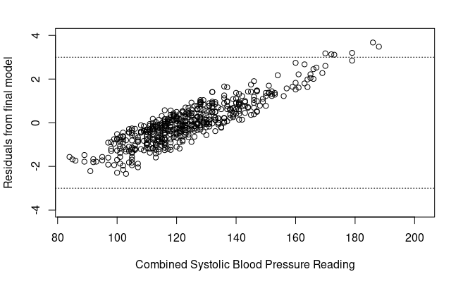
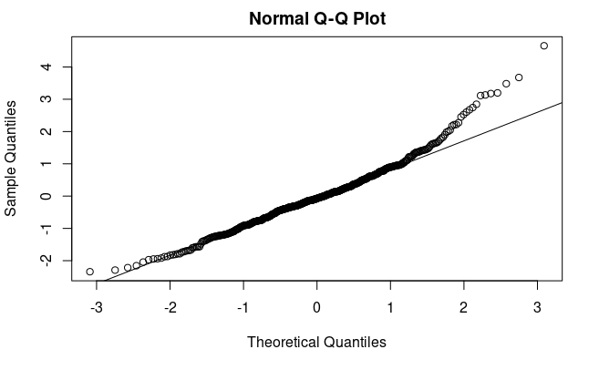
Final Model (Model Diagnostic)

Slide 19
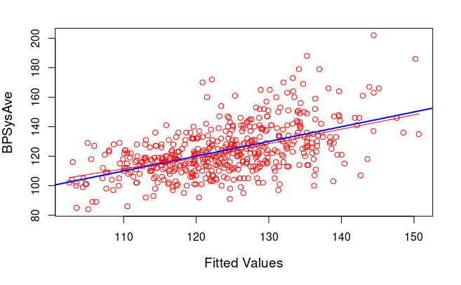
Final Model (Model Diagnostic)
This plot checks for fitted values with outcome variable, Combined Systolic Blood Pressure Reading.
Response and the predictor space have a linear relationship, which indicates no transformation is needed as such.
Both the local smoother and regression line meet which is good.

Slide 20
VIF OF FINAL MODEL
Gender | Age | Poverty | SmokeNow
1.01 | 1.11 | 1.02 | 1.14
VIF is approximately 1 for our final model predictors above, and this implies these variables are linearly independent.
All predictors above have VIF of approximately 1, this means there is there is almost no correlation between them.
Variance of these predictors is not inflated.

Slide 21
Parameter Estimates of Final Model
COEFFICIENTS:
 | Estimate | Standard Error | t-value | Pr (>|t|)
(Intercept) | 102.85 | 2.92 | 35.21 | < 2e-16
Gender (male) | 3.93 | 1.42 | 2.77 | 0.01
Age | 0.43 | 0.04 | 10.08 | < 2e-16
Poverty | -1.20 | 0.44 | -2.74 | 0.01
Smoking Cigarettes Regularly (Yes) | 0.02 | 1.50 | 0.02 | 0.99
Smoking Cigarettes Regularly: Compared to people who do not smoke regularly, the average combined blood pressure reading for those who smoke regularly is 0.02 higher.
Smoking doesn’t have a significant impact on Blood pressure.
Other variables effect on blood pressure can similarly be illustrated from the table above.

Slide 22
Conclusion
People who are in poverty, identify themselves as males, and people’s age are seen to be highly significant predictors of combined systolic blood pressure reading. According to the final model, these are the best variables for prediction.
Whereas people who do smoke cigarettes regularly is not at all a significant predictor for the combined systolic blood pressure reading. Thus, adding smoking predictor does not improve our model fit, and so we can safely remove it from our final model.
F-statistic for the final model is 30.97 and the p-value is close to 0. The model is significant at the 0.05 level, we can reject H0, meaning there is at least one significant coefficient in the model, which is good and makes sense according to our data shown previously.

